Slide 1
Backend Engineering-I Student Regis. Form
Team Details:
PRIYANKA CHAURASIA (2310992499)
PRIYANSHU MITTAL (2310992500)
PURVA BATRA (2310992501)
RAVNEET KAUR (2310992507)
Faculty Coordinator :- DR. VIJAITA KASHYAP
:
Chitkara University Institute of Engineering and Technology,
Chitkara University, Punjab

Slide 2
Table of Contents
Sr. No | Content | Page No.
1. | Introduction | 03
2. | Problem Statement | 04
3. | Key Features | 05
4. | Technical Details | 06 - 07
5. | Tags Used | 08
6. | Expanding the functionality | 09
7. | Conclusion | 10

Slide 3
Introduction
REGISTRATION FORM
BRIEF OVERVIEW:-
Purpose:
Collect and securely store user data.
Enable authentication and user identity management.
Validate and insert data into the database.
Ensure error handling and input validation.
Goals:
Scalability: Handle growing user numbers efficiently.
Automation: Trigger workflows like email verification.

Slide 4
Problem Statement
Design a secure backend registration form to collect, validate, and store user data accurately.
Provide a user-friendly experience with clear feedback and error handling.
Enable seamless integration with authentication and user management systems.
Facilitate automation for workflows like email verification and welcome messages.
Implement scalability to handle growing user bases efficiently.
Store data in a well-structured database format for easy management.
Enable compatibility with third-party services like social login (Google, Facebook).

Slide 5
Key Features
Input Validation: Validate user inputs (e.g., email format, password strength) to ensure data accuracy.
Error Feedback: Provide user-friendly error messages for invalid or incomplete entries.
Database Integration: Efficiently store user data in a structured database format.
Scalability: Handle increasing user numbers without compromising performance.
Authentication Integration: Connect seamlessly with login and authentication mechanisms.
Automation: Trigger workflows such as email verification and welcome notifications.

Slide 6
Technical Details
Frontend:
Frameworks/Libraries: Use frameworks like React for a dynamic UI.
Responsive Design: Ensure compatibility across devices using CSS frameworks like Bootstrap.
Form Validation: Implement client-side validation for fields (e.g., required fields, email format).
Error Handling: Display validation errors or backend response messages dynamically.
Security: Prevent XSS attacks by sanitizing inputs and using HTTPS for API calls.

Slide 7
Backend:
Frameworks: Use backend frameworks like Node.js.
Database: Integrate with databases like MySQL, PostgreSQL, or MongoDB for user data storage.
API Development: Create secure APIs for data handling.
Validation: Perform server-side validation for inputs to ensure data accuracy and security.
Password Security: Hash passwords using bcrypt or Argon2 for secure storage.
Error Logging: Use tools like Sentry or Winston for monitoring and debugging errors.
Scalability: Ensure scalability with load balancing and microservices architecture.

Slide 8
Tags Used
Frontend tags
HTML Tags:
<form>: For creating the registration form structure.
<input>: For text, email, password, and other user inputs.
<button>: For submitting the form.
<label>: For associating text labels with form fields.
<div>: For structuring and styling the layout.
<span>: For inline elements like error messages.
<select> and <option>: For dropdown fields, if required.
CSS Tags (Selectors):
.class: To style specific elements.
#id: For unique styling or JavaScript targeting.
:hover and :focus: For interactivity and visual feedback.
@media: For responsive design.
JavaScript/React Tags:
Event handlers: on Change, on Submit, and on Click

Slide 9
Expanding the functionality
User Feedback: Show tooltips, loading indicators, and error messages.
Multi-Step Form: Break the form into steps with a progress bar.
Social Login: Integrate Google, Facebook login options.
Error Handling: Specific feedback for each error (e.g., password strength).
Email Verification: Send confirmation email after registration.
Anti-Bot Measures: Use reCAPTCHA to prevent spam.
Password Toggle: Enable "show/hide" password option.
Responsive Design: Ensure mobile and desktop compatibility.
Mobile Optimization: Enable autofill and touchscreen-friendly design.

Slide 10
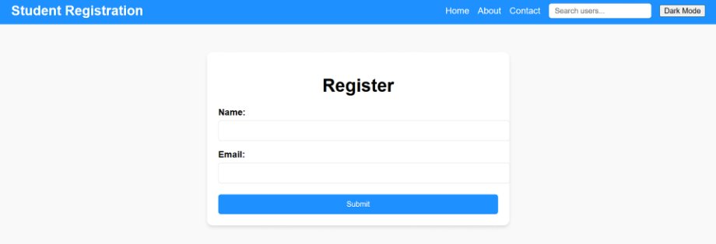

Slide 11
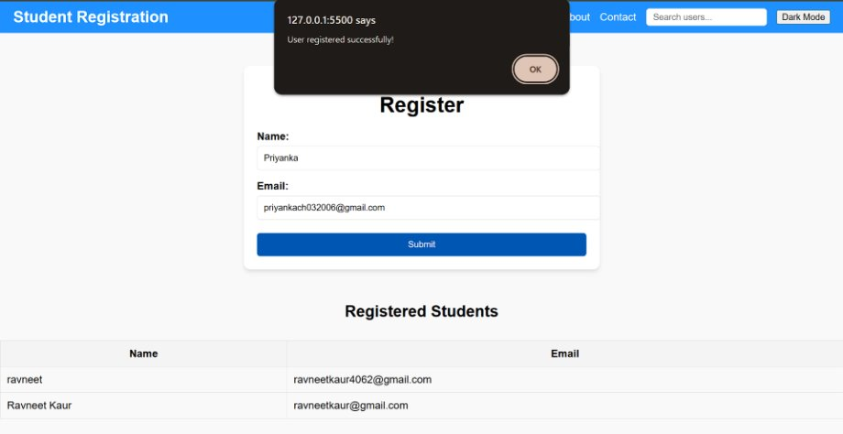

Slide 12
Conclusion
Expanding the functionality of a backend and frontend registration form improves user experience, security, and scalability. By implementing features like real-time client-side validation, social media logins, email verification, you can create a seamless and secure registration process. Additionally, enhancing the system with features like rate limiting, session management, ensures better performance and compliance with privacy regulations. Ultimately, these improvements contribute to a more efficient, user-friendly, and secure platform that can scale as user numbers grow.

Slide 13


